Slide 1
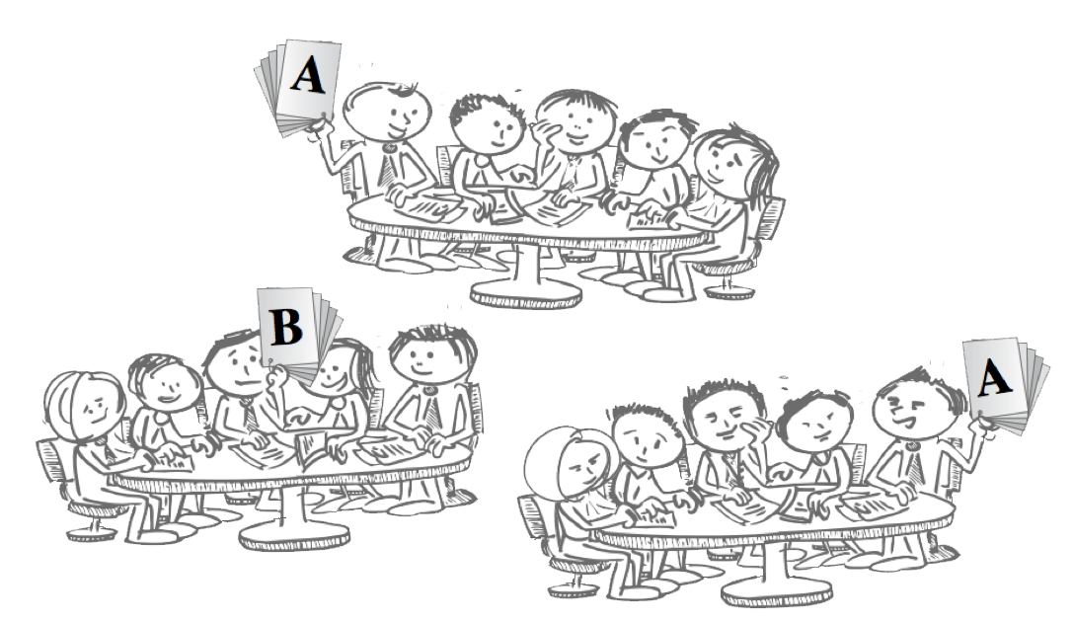
The Whole Course Experience

Slide 3
4-7 modules
Your first job is to chunk your course into…
Search for alternate
organizational metaphors
Notes:
Often requires re-chunking your course.
Textbooks often implicitly push you to a chapter a week – resist

Slide 4
Introduction to Materials Engineering
Sequentially “cover” the topics in textbook order
Glass and Ceramics
Concrete
Composites
Metals
Electronic / Optical / Semiconductors
Polymers/ Plastics

Slide 5
Introduction to Materials Engineering
New Structure: Two questions
Why did this material break/fail/melt/catch fire?
How could we pick a better material for the job?
The classes of materials can still be the “chunks” that become the modules - but now they are organized around answering the same two essential questions.
Answering both questions motivates students to want and need to understand the underlying science of each class of material.

Slide 6
Chunking your own course
Are there Essential Questions that your course tries to answer?
Are there Major Principles around which your course could be organized?
Are there Big Ideas that inform every element of your course?
Can you use Perspectives or Contextual Factors to organize your course material?
Can you use Skills or Levels or Types of Thinking to organize your content

Slide 7
Chunking Card Sort Activity 20 + 10 minutes

Slide 8
Team-Based Learning must be carefully implemented for best results!

Slide 9
Be Very Organized
TBL is not a last minute pedagogy
give yourself the gift of time
Notes:
When I interviewed people for my book…I asked…does TBL take more time to prepare….many said….NO….but it can feel like it…because ALL the preparation needs to be done up front….no wordsmithing PPT minutes before class

Slide 10
“Plans are useless, but planning is indispensable”
Dwight D. Eisenhower

Slide 11
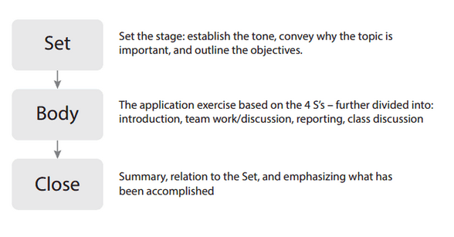

Slide 12
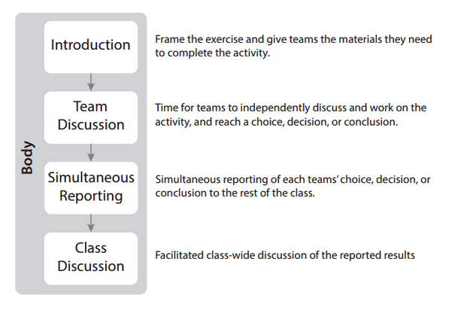

Slide 13
Sell your Rationales
Convince yourself first! Then you are ready to convince your students
Periodically remind students
Notes:
When I interviewed people for my book…I asked…does TBL take more time to prepare….many said….NO….but it can feel like it…because ALL the preparation needs to be done up front….no wordsmithing PPT minutes before class

Slide 14
Expect Resistance
“It is not a question of will there be resistance, but when and how much?”
You need to practice your words
and be emotionally ready
for some push-back

Slide 15
“I have great resistance for the first couple of weeks, until they realize how much they are learning.”
Mary Hadley
Chemistry and Geology
Minnesota State University

Slide 16
“The challenge is figuring out how to pitch the course and then managing the pushback, the resistance, and knowing in advance that the resistance is coming and there’s nothing wrong with it—it takes you two or three rounds to get to the point where you say, yeah, that’s okay.”
Bill Roberson
Faculty Developer
Vancouver Island University

Slide 17
Start Well
Importance of first class and selling TBL to your students (Gary Smith)
Periodically recapping and showing your students the value (Laura Madson)

Slide 18
Tasks for First Day of Class
Introduce TBL (Sell it!)
Form Teams
Try TBL (Show it!)

Slide 19
Gary Smith First Day Questions
Thinking of what you want to get from your college education and this course, which of the following is most important to you?
Tell me what I need to know
Develop my ability to apply what I know
Develop my life-long learning skills

Slide 20
“After the first couple of activities, at the end of the class, I try to save a few minutes to help students realize how much they have learned and to sort of translate what they just did into what a lecture could have looked like, so that they can see that all of the information that could have been in that lecture is what came up in their conversations.”
Laura Madson
Psychology
New Mexico State University

Slide 21
Last Advice
Notes:
Workshop evaluation

Slide 22
Build your Support Network
Find a co-conspirator or like-minded colleague
Reach out to your campus Teaching and Learning Centre
Join the TBL listserv (learntbl.ca/listserv)
Attend TBLC Annual meeting (teambasedlearning.org)

Slide 24
Last Review of Road Ahead
Notes:
Workshop evaluation

Slide 25
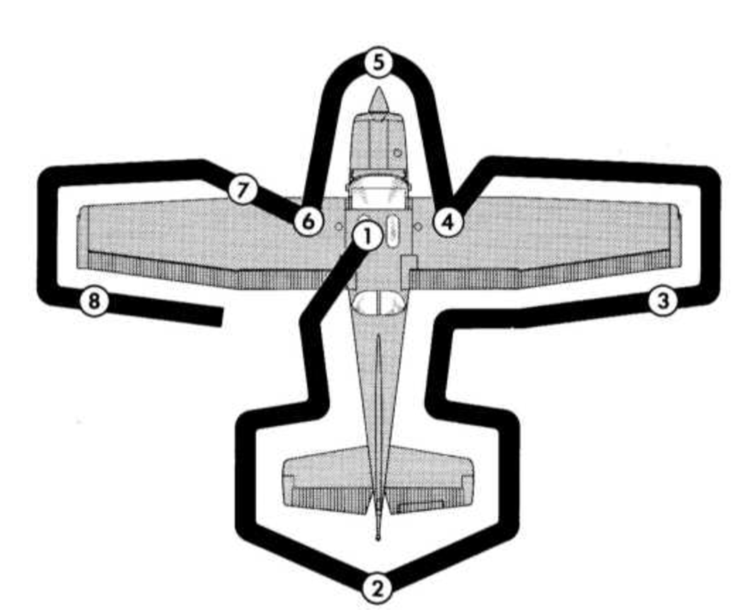
Start Course Design
Chunk course materials into 5-7 modules.
Write learning outcomes for modules.
Draft preliminary 4S application activities
Get RAP Ready
Determine required starting, testable information.
Select appropriate readings that have the above information.
Develop RAT questions
Match the RAT questions to IF-AT form
Get 4S Ready
Finish 4S team application activities.
Select reporting format and mechanism for each task (ABCDE, scoring, ranking, limited words)
Get Classroom Ready
Refine instructions and polish question prompts.
Check readings prepare students for RAT that prepares them for 4S activities.
Print classroom documents (RATs, answer sheets, activities worksheets and instructions).
Load the team folders.

Slide 26
“What do I see when TBL is implemented well? Students excited about learning, and faculty falling in love with teaching. Lots of energy in the room. Lots of engagement. The way learning should be.”
Holly Bender
Veterinary Pathology
Iowa State University

Slide 27
“The rewards are incredible. The energy in the classroom is phenomenal, and the feedback we’ve gotten from faculty is sky-high in terms of preference for TBL and not wanting to go back to lectures.”
Chris Burns
Microbiology
University of Illinois

Slide 28
Clearing the Parking Lot
Notes:
Workshop evaluation

Slide 29
Thank You

