Slide 1
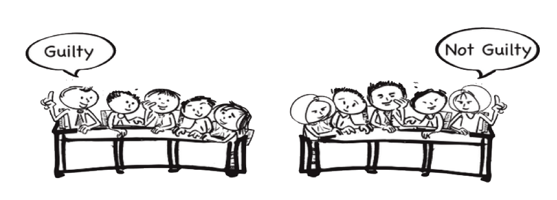

Slide 2
iRAT

Slide 3
8:00

Slide 4
7:30

Slide 5
7:00

Slide 6
6:30

Slide 7
6:00

Slide 8
5:30

Slide 9
5:00

Slide 10
4:30

Slide 11
4:00

Slide 12
3:30

Slide 13
3:00

Slide 14
2:30

Slide 15
2:00

Slide 16
1:30

Slide 17
1:00

Slide 18
:30

Slide 19
:15

Slide 20
Time’s Up!

Slide 21
tRAT

Slide 22
10:00

Slide 23
9:30

Slide 24
9:00

Slide 25
8:30

Slide 26
8:00

Slide 27
7:30

Slide 28
7:00

Slide 29
6:30

Slide 30
6:00

Slide 31
5:30

Slide 32
5:00

Slide 33
4:30

Slide 34
4:00

Slide 35
3:30

Slide 36
3:00

Slide 37
2:30

Slide 38
2:00

Slide 39
1:30

Slide 40
1:00

Slide 41
:30

Slide 42
:15

Slide 43
Time’s Up!

Slide 44
4S Team Task 1

Slide 45
6:00

Slide 46
5:30

Slide 47
5:00

Slide 48
4:30

Slide 49
4:00

Slide 50
3:30

Slide 51
3:00

Slide 52
2:30

Slide 53
2:00

Slide 54
1:30

Slide 55
1:00

Slide 56
:30

Slide 57
:15

Slide 58
Time’s Up!

Slide 59
4S Team Task 2

Slide 60
4:00

Slide 61
3:30

Slide 62
3:00

Slide 63
2:30

Slide 64
2:00

Slide 65
1:30

Slide 66
1:00

Slide 67
:30

Slide 68
:15

Slide 69
Time’s Up!

Slide 70
4S Team Task 3

Slide 72
Team Task
Examples

Slide 73
A pharmaceutical company wants to determine whether a sleeping pill is effective. They randomly assign individuals either to take a sleeping pill or to take a placebo. They compare the amount of time participants are asleep. They hypothesize the sleeping pill group will sleep longer than the placebo group.
a. Chi-square goodness of fit test
b. Contingency table analysis (chi-square test of independence)
c. This can’t be analyzed using a chi-square!!
Source: Marie Thomas

Slide 74
The blood was drawn from the men in the fed state. Which one of the statements below provides the best support for their being in the fed state?
A. Glucagon levels in the men are too high to indicate the fasted state.
B. Glucose levels in the men are the strongest indicators of the fed state.
C. The observed levels of liver synthesized plasma proteins albumin and transferrin are diagnostic for the fed state.
D. Low levels of free fatty acids and ketone bodies (acetoacetate and β-OH butyrate) coupled with relatively high levels of insulin suggest the fed state.
E. The RQ near 1 rules out vigorous exercise and must be related to the fed state.

Slide 75
A patient come into emergency with the following symptoms...
What is the first thing you would do? And why?
B. What is the first test you would order? And why?
C. What would be the worst thing to do? And why?

Slide 76
You are consulting for a new business owner who wants to open a dry-cleaning store in Norman, Oklahoma. Where would you recommend locating a new dry-cleaning business (and why)?

Slide 77
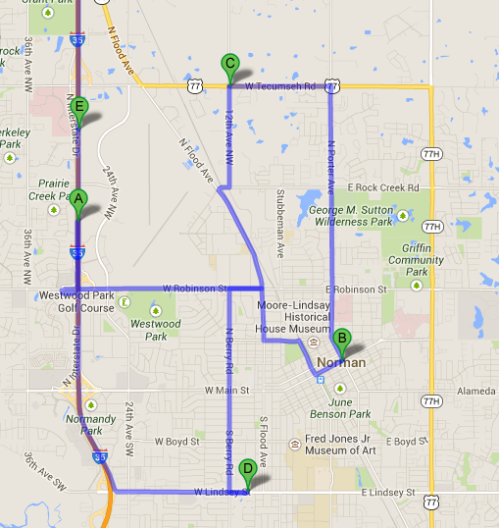
Push Pin in Map

Slide 78
4S Task Reporting Options

Slide 79
Team Task Examples

Slide 80
Excel - Part 2

Slide 81
Excel Reporting
Instructor enters numerical positions then displays all at once
One page summary– principles and approach and not calculations (16 pt font or bigger)
Excel – Part 3

Slide 82
A patient come into emergency with the following symptoms... (ADD appropriately COMPLEX SCENARIO HERE)
What is the first thing you would do? And why?
B. What is the first test you would order? And why?
C. What would be the worst thing to do? And why?

Slide 83
Small Whiteboards

Slide 84
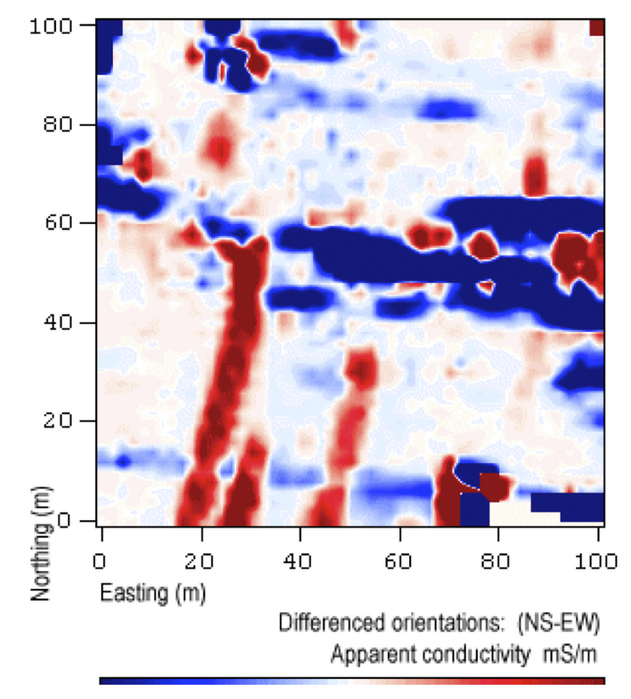
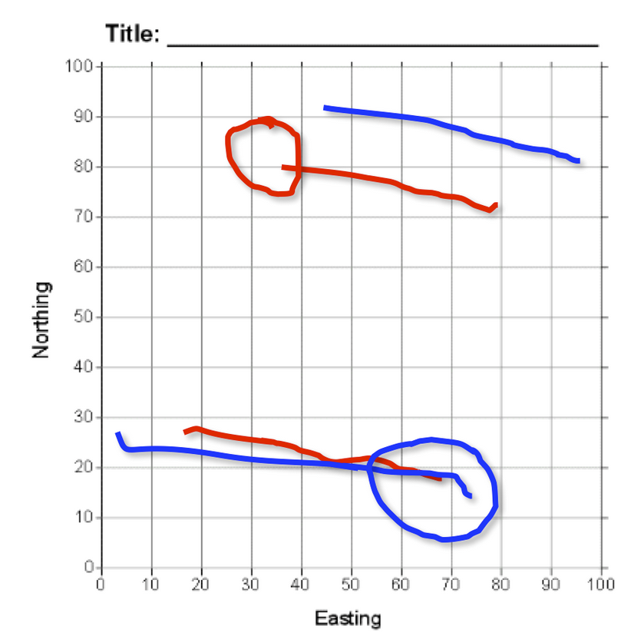
The image on the left is the original data graphic provided to teams, and the image on the right is an overlay of the responses from two teams, each using their own color. Teams were required to interpret the data by identifying two linear features with lines and the location of one additional feature with a circle.
Stacked Overheads
Jones, 2009

Slide 85
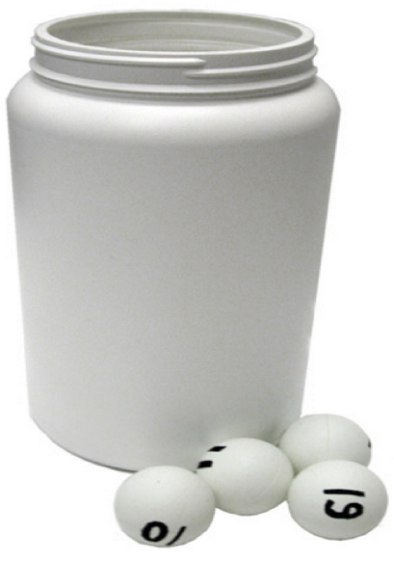
Hot Seat 1

Slide 86
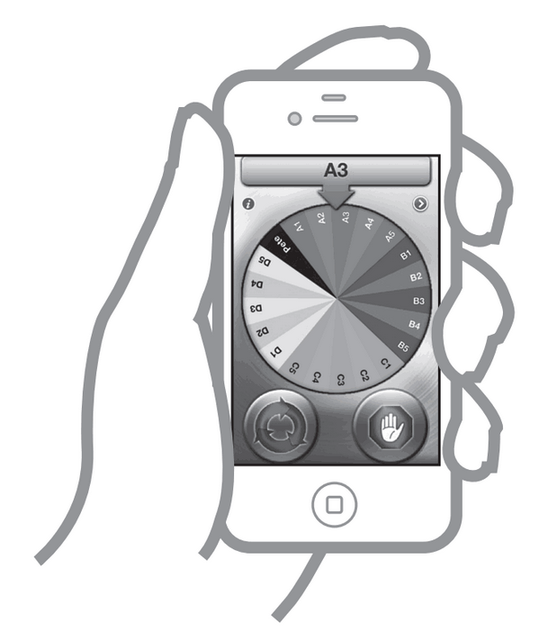
Hot Seat 2
Pick Me or YouSpin for iPhone

Slide 87
Post-it note: Horse race

Slide 88
4S Activity
Writing Tips

Slide 89
Knowledge from READING
Observation of new situation
Analysis of situation
Judgment
Specific Claim
From Bill Roberson

Slide 90
4S Task Writing Process
Identify concrete situation where a disciplinary expert would be asked to make a decision
Embellish the concrete situation by writing a scenario that describe the situation and includes details, data sets, and other information for student to use in their analysis
Ask a judgment question that requires the students to analyze situation (score, rank, best, worst…)
Write constrained options (possible courses of action)….all options should be plausible and competitive

Slide 91
Shape of 4S Task
Concrete situation description
4S
Prompt
Something to analyze – to understand more about situation
Stories, images, evidence, articles, charts, data sets, test results, text passages
A decision to be made - question with a superlative so teams are forced to make a decision and pick one option - rank, score, sort, best, worst, cheapest, most efficient, first, last, etc.
A. One possible, plausible, competitive course of action/decision
Possible decisions
B. Another possible, plausible, competitive course of action/decision
C. Another possible, plausible, competitive course of action/decision
D. Another possible, plausible, competitive course of action/decision

Slide 92
STUCK - you can start with question style
Select from limited options
Rank
Best Answer within given options
Scoring (on a scale)
Binary (T/F; Yes/No; Up/Down; Left/Right; higher/lower; out/in)
Sequencing/organizing - chronological; procedural; logical; values; categories; narrative
Identify outlier or what does not belong?
Numerical estimate (not long calculations)
Single word or sentence
Specific # of words (to force compaction)
Notes:
There is more in your Notebooks: look at Team Application Task Section

Slide 93
Binder
Tour

Slide 94
Voice of Experience

Slide 96
Homework
Tasking

Slide 97
Wednesday Office Hours
10:00 am to 3:00 pm
by appointment
jim.sibley@ubc.ca

Slide 98
End of Day Reflections

